Slide 1
TIME AND DYNAMICS OF INSTAGRAM USERS : A STATISTICAL ANALYSIS
TATHAGATA BARDHAN
ROLL NO.- 461

Slide 2
An Introduction
Instagram (also known as IG or insta) is a photo and video-sharing social networking service owned by Facebook, Inc. It was created by Kevin Systrom and Mike Krieger, and launched in October 2010 exclusively on iOS. A version for Android devices was released a year and half later, in April 2012, followed by a feature-limited website interface in November 2012, and apps for Windows 10 Mobile and Windows 10 in April 2016 and October 2016 respectively. Following the release in October, Instagram had one million registered users in December 2010 which gradually increased to 800 million in September 2017.
Thus, as time passes on people of all communities are getting addicted to this social media platform, irrespective of age, gender, religion. Instagram’s most active users are in the 18-29 years age group as all of us know this generation is more techsavy.

Slide 3
Apart from this there are some interesting speculations regarding the gender dynamics. According to some research reports, more women than men are using Instagram. Female users are believed to be more popular than male users which can be guessed from the fact that six of the top 10 most followed Instagram accounts are owned by women.
But, is there any truth in such statements? Or, are these just headlines made-up to grab eyeballs?
Can the gender of a person be predicted from his/her activities on Instagram? How the activities of an user on Instagram are influenced by their daily lives?
All these questions are going to be answered in this project. I intend to use a number of statistical techniques in my study to arrive at certain conclusions.

Slide 4
DATA DESCRIPTION
The datasets in hand provides data on “Time and Dynamics of Instagram Users” obtained from the following source : (https://zenodo.org/record/1439178#.W7HNY3szaM8) The salient features of the data are given below:
There are two datasets : the first one encompasses data for 78 Instagram users chosen randomly on 3rd April, 2017 on some categories and the second one is of the same users after 150 days.
There is also another bigger dataset sampled on 818 Instagram users on some dates of March, April 2017 taken altogether.

Slide 5
Data gathered for each user includes:
1-Number of posts made by an user.
2-Number of followers of that user.
3-Number of followings of his/her.
4-Number of likes for the tenth previous post made by him/her.
5-Number of likes for the eleventh previous post made by him/her
6-Number of likes for the twelfth previous post
7-Number of self-presenting posts from nine previous posts
8-Gender.
Type of the data: “Count Data” on the Instagram users on several categories and classified according to gender describing the activities of people using Instagram in their daily lives.

Slide 6
METHODOLOGY
In order to draw conclusions from the data, I check the characteristics of the data and then go for various tests of association, regression analysis along with some graphical representations. The types of the data in hand are frequency data and so valid tests are applied here which are applicable in practical situations. The following tests and analysis are used:
Pearsonian Chi-Square test for homogeneity.
Binary Logistic regression.
Multiple linear regression.
The test procedures have been discussed in details in the paper.

Slide 7
Is the popularity of the users in Instagram gender – dependent?
NAME | NO. OF FOLLOWERS | GENDER
User 1 | 279 | m
User 2 | 5,509 | f
User 3 | 453 | f
User 4 | 1,231 | m
User 5 | 9,620 | m
User 6 | 1,282 | m
User 7 | 2,312 | m
User 8 | 1,819 | f
User 9 | 2,056 | f
User 10 | 2,403 | f
User 11 | 7,355 | m
. . . | . . . | . . .
user 816 | 2,326 | f
user 817 | 286 | f
user 818 | 1,587 | f
To compare the popularities of males and females in this social media platform and to check whether there is any dependency of the popularity on the gender of an user, here the Pearsonian chi-square homogeneity test has been used.
For this analysis, data on 818 Instagram users has been extracted and the gender of each user and his/her no. of followers i.e., number of people following his/her account has been noted and this data has been presented in a tabular form.

Slide 8
The above data has been summarized in the following 5 x 2 contingency table taking the no. of followers.
Here, we assume that data is collected separately according to males and females and then classified according to different ranges of no of followers on Instagram. Thus the 2 samples of males and females are independent. Let p_{ij} denote the population proportion of the jth gender belonging to the ith class of no. of followers. i=1(1)5, j=1,2.
No. of followers | 0-2000 | 2000-4000 | 4000-6000 | 6000-8000 | 8000-10,000
Males | 324 | 36 | 17 | 12 | 18
Females | 309 | 61 | 23 | 14 | 4
Total | 633 | 97 | 40 | 26 | 22

Slide 9
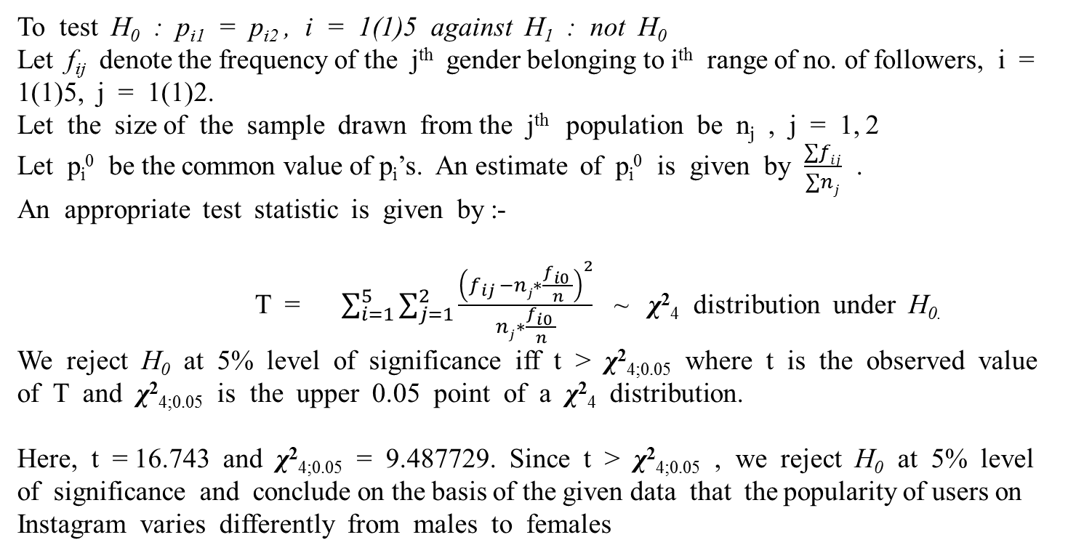

Slide 10
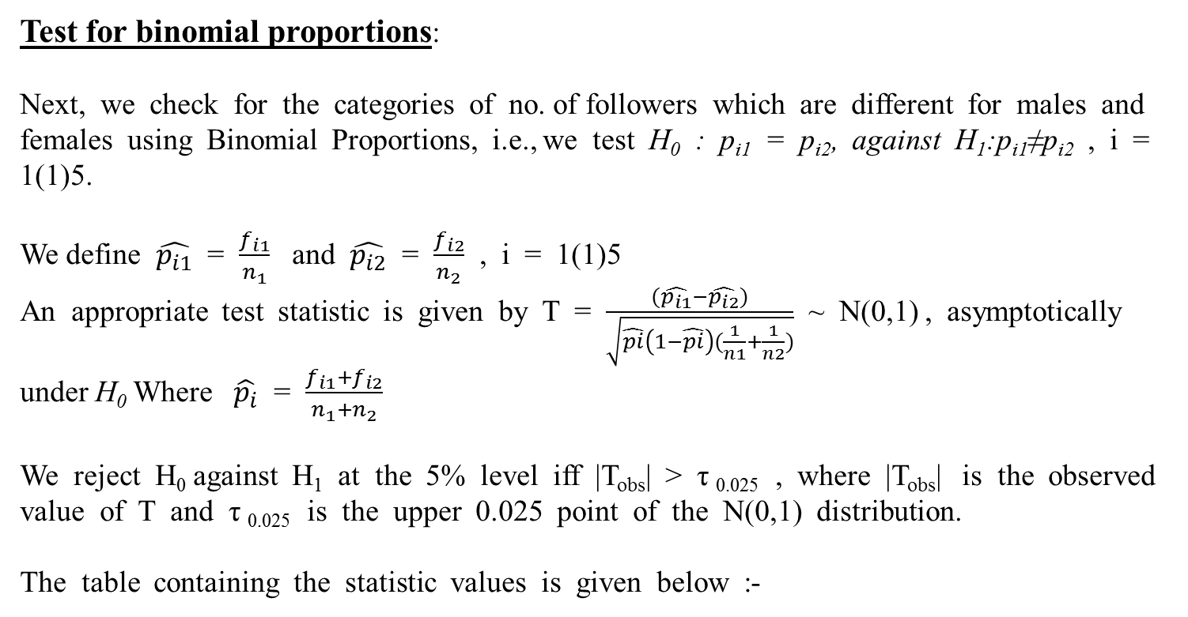

Slide 11
I | Tobs
1 | 1.512398
2 | -2.62986
3 | -0.9410646
4 | -0.373283
5 | 3.04906
So the |T_{obs}| value for the class of followers “2000-4000” and for the class of followers “8000-10,000” is > τ _{0.025} (= 1.959964) .Thus for these two classes the no. of followers for male and female vary differently. We see that all other T- values are lesser than the cut-off point.
But we notice that the T-value corresponding to the group “0-2000” no. of followers is quite close to the cut-off point which means that although not significant but the males and female belonging to that group still vary with respect to popularity.
And very lower value for the group “6000-8000 no. of followers” indicates almost equal popularity for males and females belonging to this group of no. of followers.

Slide 12
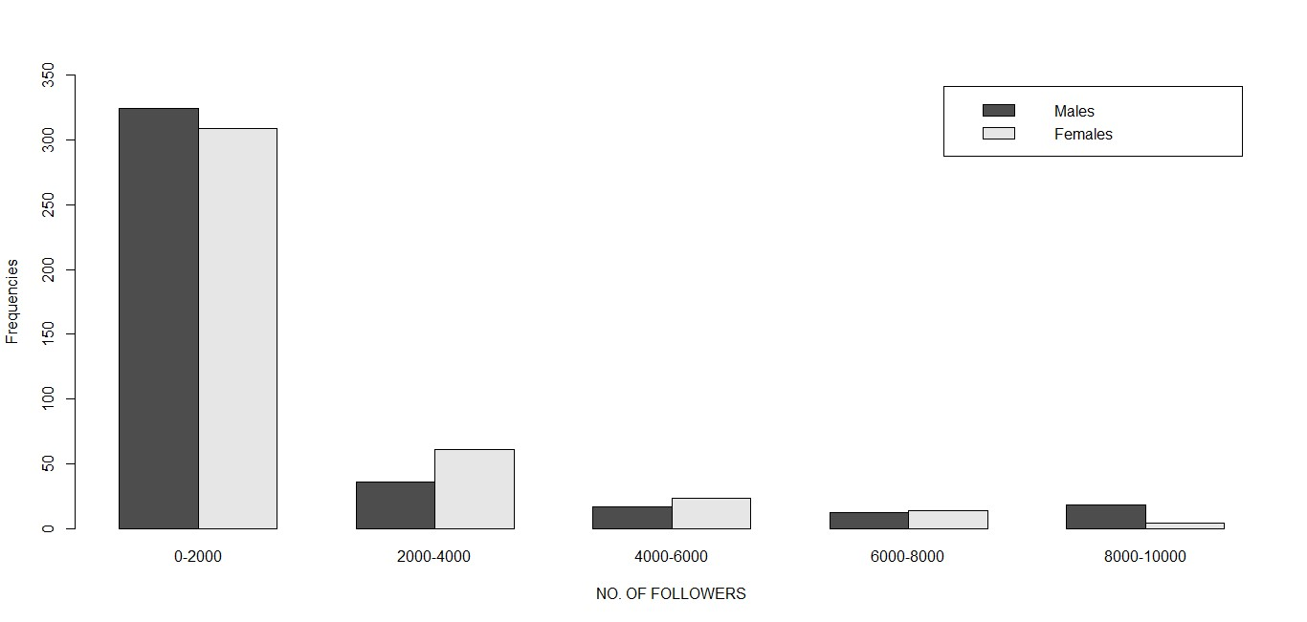
Conclusions: Maximum no. of people have no. of followers from 0-2000. People with greater number of followers (2000-6000) are mostly females whereas there are almost same no .of males and females having no. of followers 6000-8000 and greater number of males have no. of followers more than 8000.

Slide 13
Are all the males and females equally active on Instagram?
To compare the addiction of males and females towards this social media platform and to check whether males and females are equally active, Pearsonian Chi-square test of homogeneity is again used.
For this analysis, data on these 818 users and the gender of each user is noted and the no. of posts made by each user from the day he/she has opened the account till the date of this data collection is presented in a table.
NAME | NO. OF POSTS | GENDER
User 1 | 486 | m
User 2 | 401 | f
User 3 | 463 | f
User 4 | 154 | m
User 5 | 786 | m
User 6 | 405 | m
User 7 | 638 | m
User 8 | 73 | f
User 9 | 600 | f
User 10 | 57 | f
User 11 | 400 | m
. . . | . . . | . . .
user 816 | 164 | f
user 817 | 89 | f
user 818 | 83 | f

Slide 14
We summarize the above data provided on 818 Instgram users into a 5 x 2 contingency table representing the no. of posts made separately by males and females
Gender | Male | Female | Total
No. of posts
0-500 | 325 | 300 | 625
500-1000 | 52 | 66 | 118
1000-1500 | 13 | 23 | 36
1500-2000 | 7 | 9 | 16
>2000 | 10 | 13 | 23
Total | 407 | 411 | 818
Here, we assume that data is collected separately according to males and females and then classified according to the no. of posts made by each user. Thus the 2 samples of males and females are independent

Slide 15
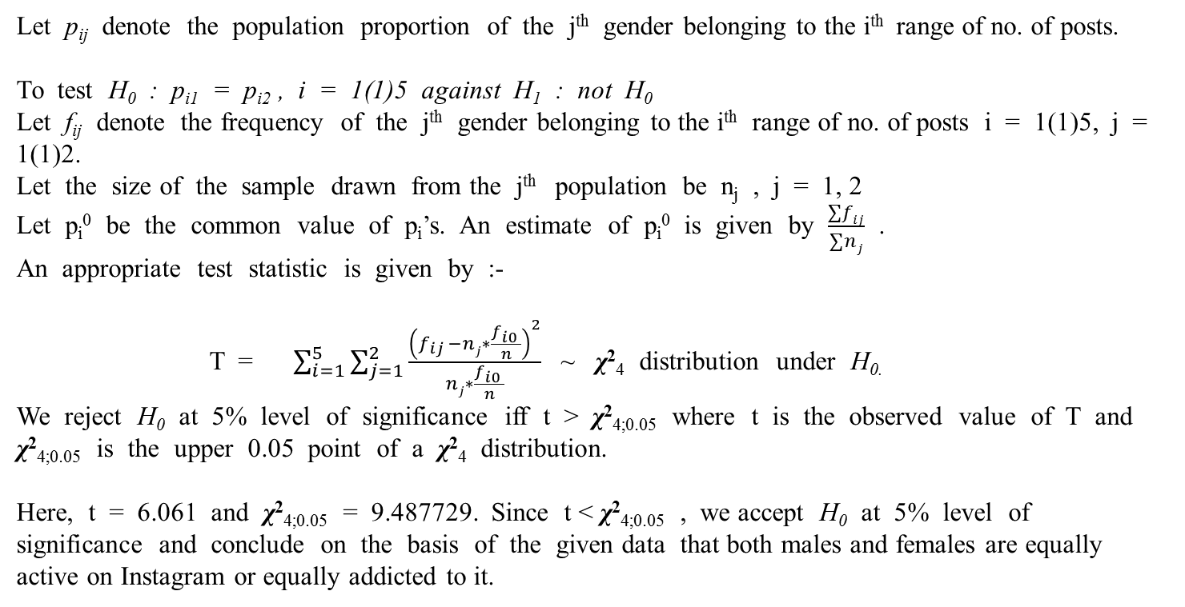

Slide 16
Can the gender of an individual be correctly predicted from his/her activities on Instagram ?
To check whether the gender of the 78 Instagram users on 30 Aug, 2017 can be correctly predicted using the data on 3rd April, 2017, binary logistic regression is used.
Response(y) : gender(male/female).
Predictors :
1-Number of posts made by an user till that date(x₁)
2-Number of followers of that user(x₂)
3-Number of followings of his/her(x₃)
4-Number of likes for the tenth previous post made by him/her(x₄)
5-Number of likes for the eleventh previous post made by him/her(x₅)
6-Number of likes for the twelfth previous post(x₆)
7-Number of self-presenting posts from nine previous posts(x₇)

Slide 17
Name | x₁ | x₂ | x₃ | x₄ | x₅ | x₆ | x₇ | gender
User 1 | 633 | 566 | 500 | 61 | 61 | 71 | 8 | F
User 2 | 145 | 1186 | 651 | 89 | 88 | 99 | 3 | F
User 3 | 477 | 424 | 324 | 88 | 76 | 68 | 8 | F
User 4 | 1313 | 939 | 194 | 67 | 45 | 67 | 6 | F
User 5 | 904 | 1929 | 2242 | 15 | 9 | 16 | 0 | M
User 6 | 205 | 4495 | 739 | 243 | 167 | 128 | 8 | M
User 7 | 241 | 2309 | 669 | 1143 | 1166 | 1192 | 9 | M
User 8 | 1997 | 5209 | 1449 | 74 | 76 | 70 | 8 | F
User 9 | 132 | 2393 | 932 | 221 | 305 | 71 | 5 | F
User 10 | 375 | 4572 | 220 | 418 | 106 | 171 | 4 | F
User 11 | 498 | 107 | 367 | 27 | 29 | 9 | 3 | F
. | . | . | . | . | . | . | . | .
. | . | . | . | . | . | . | . | .
User 77 | 123 | 423 | 688 | 28 | 8 | 11 | 1 | F
User 78 | 83 | 4061 | 688 | 425 | 385 | 395 | 8 | F

Slide 18
Probability of an user being a female is taken as a success, the success probability being p. Thus our objective is to model log p/(1-p) on x₁, x₂, x₃, x₄, x₅, x₆, x₇
CHECKING THE ASSUMPTIONS OF LOGISTIC REGRESSION:
INDEPENDENCE OF OBSERVATIONS : Here, we assume that data is collected separately for the males and females and then classified according to the number of posts, no of followers, no. of followings, no of likes obtained for the 10th, 11th, 12th previous post, and no of self-presenting post of the last 9 posts for each of the males and females.
Thus the 2 samples of males and females are independent
CHECKING MULTICOLLINEARITY: Next we check for the linear or near perfect linear correlation between the predictors before performing the regression in order to see whether there is multi-collinearity in the data.
For this the pairwise Pearson-product moment correlation coefficients are obtained for the 7 predictors and are listed below:

Slide 19
 | x₁ | x₂ | x₃ | x₄ | x₅ | x₆
x₂ | 0.006
x₃ | 0.070 | 0.390
x₄ | -0.248 | 0.525 | 0.082
x₅ | -0.255 | 0.549 | 0.115 | 0.931
x₆ | -0234 | 0.607 | 0.190 | 0.841 | 0.930
x₇ | -0.036 | 0.271 | 0.007 | 0.373 | 0.371 | 0.293
So it can be seen that highly correlated variables are:
(x₄, x₅) with correlation coefficient 0.931
(x₄, x₆) with correlation coefficient 0.841
(x₅, x₆) with correlation coefficient 0.930
So, it can be seen that multi-collinearity is present in the data

Slide 20
REMEDIAL MEASURES:
The following remedial measures are taken to remove multi-collinearity from the data:
1.TRANSFORMATION OF VARIABLES :
x₄, x₅, x₆ being the number of likes obtained by the users for the 10th, 11th, 12th previous posts are similar type of variables. A new variable is defined which is the average of the number of likes obtained by the users for the 10th, 11th, 12th previous posts and it is taken as a new predictor along with the other predictors.
So, we perform a logistic regression taking sex as the dichotomous response variable(y) regressing on the following predictors:
Number of posts made by an user on a certain date(x₁)
Number of followers of that user(x₂)
Number of followings of his/her(x₃)
Average of the number of likes obtained for the tenth, eleventh and twelfth previous post made by him/her(x₄)
Number of self-presenting posts from nine previous posts(x₅)

Slide 21
So, y_{α} = β₁x_{1α}+β₂x_{2α}+……..+β₅x_{5α} model is fitted. α= 1(1)78 here y_{α} = log p_{α}/ (1-p_{α}) or the log (odds) where p_{α} is the probability of αth user being female.
The parameters are estimated in the model using an iterative re-weighted least square algorithm to obtain the maximum likelihood estimates of the parameters by which we obtain the estimates given as : (0.000903, 0.000252, -0.000510,-0.00056, -0.1283)
Thus fitted regression equation of y on x₁, x₂, x₃, x₄, x₅: Y_{α} = 0.000903 x_{1α} + 0.000252 x_{2α} - 0.000510 x_{3α} - 0.00056 x_{4α}- 0.1283 x_{5α} where Y_{α} is the predicted value of y_{α.}
Checking Variance Inflation Factors (VIFs) for Multi-collinearity: The speed with which variances and co-variances of the Least Square estimators increase can be estimated by Variance Inflation Factors (VIFs) which is defined as 1/(1-R_{i}²) where R_{i}² is the coefficient of determination of the regression equation when the predictor x_{i} is regressed on all other predictors.

Slide 22
VIF shows how the variance of an estimator is inflated in presence of multi-collinearity
Estimated coefficients | VIFs
0.000903 | 1.76
0.000252 | 4.24
-0.000510 | 2.18
-0.00056 | 3.14
-0.1283 | 2.64
Conclusion: Highest value of the VIF corresponding to the estimate of β₂ defined as 1/(1-R₂²) indicates how the variance of its estimator is inflated in presence of multi-collinearity where R₂² is the coefficient of determination of the regression equation when x₂ is regressed on all other predictors.

Slide 23
2. DROPPING OF A VARIABLE: Value of the VIF corresponding to the estimate of β₂ is the highest, so we drop the variable x₂ as our next remedial measure and again perform regression of y on x₁, x₃, x₄, x₅ using a no-intercept model y_{α} = β₁x_{1α}+β₃x_{3α}+β₄x_{4α} +β₅x_{5α} for all α = 1(1)78. Estimating the parameters in the process mentioned above the following fitted regression equation is obtained: Y_{α} = 0.001033 x_{1α} - 0.000342 x_{3α} + 0.00090 x_{4α} - 0.1021 x_{5α} for all α = 1(1)78 where Y_{α} is the predicted value of y_{α.}
Pairwise correlation coefficient values of x₁, x₃, x₄, x₅ :
Estimated coefficients | VIFs
0.001033 | 1.71
- 0.000342 | 1.72
0.00090 | 2.06
- 0.1021 | 2.52
 | x₁ | x₃ | x₄
x₃ | 0.07
x₄ | -0.254 | 0.133
x₅ | -0.036 | 0.007 | 0.358
Not so high values of the VIFs corresponding to the estimators of the parameters and the values of the pairwise correlation coefficient values of x₁, x₃, x₄, x₅ indicate that there is no multi-collinearity in the data.

Slide 24
Test for significance of regression and individual regression coefficients :
DEVIANCE TABLE
SOURCE | P-VALUES
Regression | 0.068
X₁ | 0.011
X₃ | 0.077
X₄ | 0.434
X₅ | 0.133
Conclusions: For the data, the p-value for testing that all slopes are zero is 0.068. We test at 10% level of significance i.e. at an α-level of 0.1. Because 0.068 is less than 0.1, we conclude that there is a significant relationship between the response and at least one of the predictor variables.
And from the p-values of the predictors we can conclude that at 10% level of significance both the predictors x₁ and x₃ are significant.

Slide 25
PREDICTION OF GENDER OF THE INSTAGRAM USERS AFTER 150 DAYS:
Thus the final model Y_{α =} 0.001033 x_{1α –} 0.000342 x_{3α} is chosen and is used for predicting gender for the given data of the 78 Instagram users after 150 days and it is to see how many of them matches with the original data.
Putting the values of x₁ and x₃ of the data on Instagram users on 30th Aug, 2017 ( data on the users after 150 days) in the above obtained model, the response Y_{α} = log p_{α}/ (1-p_{α}) is predicted from which the values of p_{α}’s are obtained as p_{α} = e^{Yα}/(1+e^{Yα}).
Now using the R code: rbinom(1,1,p_{α}) for each value of p_{α} the predicted values of the gender are obtained as 1 (female) or 0 (male) since the probability of an user being a female was taken as the success probability.
Now it is checked for the number of matches with the actual data after 150 days.

Slide 26
Data on the Instagram users on 30 Aug, 2017(after 150 days):
Name | x₁ | x₃ | Y_{α} | p_{α} | Gender | Predicted gender | Decision
User 1 | 658 | 393 | 0.54531 | 0.77827 | F | 1 | Match
User 2 | 133 | 692 | -0.09928 | 0.4431 | F | 1 | Match
User 3 | 490 | 328 | 0.39399 | 0.71243 | F | 1 | Match
User 4 | 1439 | 223 | 1.41022 | 0.96257 | F | 1 | Match
User 5 | 919 | 2094 | 0.23318 | 0.63109 | M | 1 | Not match
User 6 | 211 | 833 | -0.06692 | 0.46155 | M | 0 | Match
User 7 | 238 | 1243 | -0.17925 | 0.39825 | M | 0 | Match
User 8 | 2235 | 1564 | 1.77387 | 0.98345 | F | 1 | Match
User 9 | 158 | 983 | -0.17297 | 0.40173 | F | 0 | Not match
User 10 | 371 | 175 | 0.32339 | 0.67801 | F | 1 | Match
User 11 | 502 | 246 | 0.43443 | 0.73112 | F | 1 | Match
User 12 | 105 | 198 | 0.04075 | 0.52344 | M | 0 | Match
User 13 | 102 | 1014 | -0.24142 | 0.36449 | M | 0 | Match
User 14 | 640 | 539 | 0.47678 | 0.74593 | F | 1 | Match
User 15 | 1255 | 486 | 1.13020 | 0.93101 | M | 1 | Not match

Slide 27
Name | x₁ | x₃ | Y_{α} | p_{α} | Gender | Predicted gender | Decision
User 16 | 1592 | 63 | 1.6299 | 0.97673 | M | 1 | Not match
User 17 | 570 | 354 | 0.46774 | 0.74593 | F | 1 | Match
User 18 | 1838 | 60 | 1.87813 | 0.98693 | M | 1 | Not match
User 19 | 75 | 1285 | -0.3620 | 0.3029 | M | 0 | Match
User 20 | 220 | 429 | 0.08054 | 0.54623 | M | 1 | Not match
User 21 | 479 | 767 | 0.23249 | 0.63073 | M | 0 | Match
User 22 | 1145 | 535 | 0.99981 | 0.90906 | M | 1 | Not match
. | . | . | . | . | . | . | .
. | . | . | . | . | . | . | .
. | . | . | . | . | . | . | .
User 77 | 228 | 827 | -0.04731 | 0.47279 | F | 1 | Match
User 78 | 148 | 683 | -0.0807 | 0.45367 | F | 1 | Match
Conclusion: It can be seen that using the model fitted on the data of the Instagram users as noted on 3rd April, 2017, gender of 47 users can be predicted correctly out of the 78 users of the data on 30th Aug, 2017. i.e. around 60% of the gender of the users can be successfully predicted after 150 days from their activities on Instagram

Slide 28
How is the daily life of female users reflected through social media?
To perform an analysis on, the data on 39 females among the 78 Instagram users on 3rd April, 2017 is taken and a multiple linear regression model is fitted with the logarithm of the avg. no. of likes obtained by each female for the 10th, 11th, 12th previous post, taken as the response(y) on the following variables as predictors:
Proportion of the no. of posts made by each user till 3rd April, 2017(x₁)
Proportion of no. of followers of each female(x₂)
Proportion of no. of followings of each female(x₃)
Proportion of the no. of self-representing posts out of the nine previous posts(x₄).

Slide 29
So, y_{α} = β₀ + β₁x_{1α} + β₂x_{2α} + β₃x_{3α} + β₄x_{4α} + u_{α} model is fitted. α= 1(1)39 where β₀ , β₁ , β₂ , β₃ , β₄ are parameters to be estimated by the method of ordinary least squares and u_{α} are some stochastic disturbance terms(unobservable) associated with the model.
So, the fitted regression equation of y on x₁, x₂, x₃, x₄:
Y_{α} = 3.840 - 11.84x_{1α} + 26.26x_{2α} + 5.21x_{3α} + 5.69x_{4α} where Y_{α} is the predicted value of y_{α} .
Checking the assumptions of multiple linear regression analysis:
1.Normality assumption of the response: we assume that the stochastic disturbances and hence the response variable are normally distributed. Here we perform Shapiro Wilk test on the response variable to check whether the response variable is normally distributed. As a test procedure we are to test H₀: the variables are normally distributed against H₁: not H₀.
The p-value of the test obtained is 0.1746 > 0.05(desired level of significance), so, we accept H₀ and conclude on the basis of given data that the response variable is normally distributed.

Slide 30
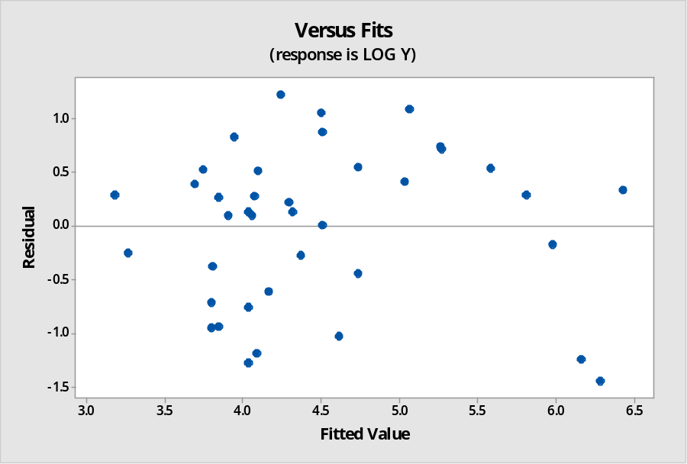
Checking the assumptions of homoscedasticity and multi-collinearity :
Residual plot :
Plot of residuals vs. fitted values donot show any systematic pattern. So, the error terms are homoscedastic.
Pairwise correlation coefficient values:
VIF values obtained from regression:
So, no severe multi-collinearity problem here.
 | x₁ | x₂ | x₃
x₂ | -0.005
x₃ | 0.473 | 0.314
x₄ | 0.106 | 0.399 | -0.043
Term | VIF
x₁ | 1.42
x₂ | 1.48
x₃ | 1.62
x₄ | 1.32

Slide 31
Test for significance of regression and individual regression coefficients :
The p-value of the F-test of significance for the regression model(0.000) shows that the model estimated by the regression procedure is significant at an α-level of 0.05. This indicates that at least one coefficient is different from zero.
The p-values of the t-tests for the estimated coefficients of x₁ and x₂ are respectively 0.025 and 0.000, indicating that they are significantly related to the avg. no. of likes obtained. The p-value for other estimated coefficients are >0.05, indicating that they are not related to avg. no. of likes at an α-level of 0.05.
source | p-values
Regression | 0.000
x₁ | 0.025
x₂ | 0.000
x₃ | 0.375
x₄ | 0.414
.
Conclusion : The no. of likes obtained by each female user for the tenth, eleventh and twelfth previous post depends on the no. of posts made by each user and her no. of followers.

Slide 32
How is the daily life of male users reflected through social media?
We perform a similar type of analysis for this on the data of 39 females among the 78 Instagram users on 3rd April, 2017. A multiple linear regression model is fitted with the logarithm of the avg. no. of likes obtained by each male for the 10th, 11th, 12th previous post, taken as the response(y) on the following variables as predictors:
Proportion of the no. of posts made by each user till 3rd April, 2017(x₁)
Proportion of no. of followers of each male(x₂)
Proportion of no. of followings of each male(x₃)
Proportion of the no. of self-representing posts out of the nine previous posts(x₄).

Slide 33
So, y_{α} = β₀ + β₁x_{1α} + β₂x_{2α} + β₃x_{3α} + β₄x_{4α} + u_{α} model is fitted. α= 1(1)39 where β₀ , β₁ , β₂ , β₃ , β₄ are parameters to be estimated by the method of ordinary least squares and u_{α} are some stochastic disturbance terms(unobservable) associated with the model. So, the fitted regression equation of y on x₁, x₂, x₃, x₄:
Y_{α} = 3.787 - 16.37x_{1α} + 27.88x_{2α} -2.91x_{3α} + 24.9x_{4α} where Y_{α} is the predicted value of y_{α}
Checking the assumptions of multiple linear regression analysis:
1.Normality assumption of the response: We assume that the stochastic disturbances and hence the response variable are normally distributed. Here we perform Shapiro Wilk test on the response variable to check whether the response variable is normally distributed. As a test procedure we are to test H₀: the variables are normally distributed against H₁: not H₀.
The p-value of the test obtained is 0.7825 > 0.05(desired level of significance), so, we accept H₀ and conclude on the basis of given data that the response variable is normally distributed.

Slide 34
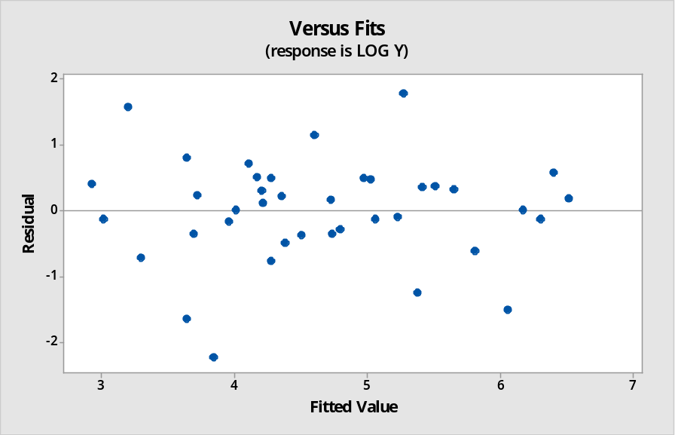
Checking the assumptions of homoscedasticity and multi-collinearity :
Residual plot :
Plot of residuals vs. fitted values donot show any systematic pattern. So, the error terms are homoscedastic.
Pairwise correlation coefficient values:
VIF values obtained from regression:
So, there is no severe multi-collinearity here.
 | x₁ | x₂ | x₃
x₂ | 0.019
x₃ | -0.212 | 0.482
x₄ | -0.168 | 0.173 | -0.039
Term | VIF
x1 | 1.12
x2 | 1.42
x3 | 1.45
x4 | 1.10

Slide 35
Test for significance of regression and individual regression coefficients :
The p-value of the F-test of significance for the regression model(0.000) shows that the model estimated by the regression procedure is significant at an α-level of 0.05. This indicates that at least one coefficient is different from zero.
The p-values of the t-tests for the estimated coefficients of x₁, x₂ and x₄ are respectively 0.010, 0.000 and 0.006, indicating that they are significantly related to the avg. no. of likes obtained. The p-value for other estimated coefficients are >0.05, indicating that they are not related to avg. no. of likes at an α-level of 0.05.
Source | p-values
Regression | 0.000
x₁ | 0.010
x₂ | 0.000
x₃ | 0.598
x₄ | 0.006
Conclusion : The no. of likes obtained by each male user for the tenth, eleventh and twelfth previous post depends on the no. of posts made by each user, his no. of followers as well as the no. of self-representing posts out of nine previous posts.

Slide 36
CONCLUSION
We have seen that the popularity of the users on Instagram varies differently from males and females. The users who have more number of followers are mostly females whereas there are almost same no. of males and females having no. of followers 6000-8000. We have also seen that both males and females are equally active on Instagram or equally addicted to it.
And we have seen that the gender of about 60% of the users can be correctly predicted from their activities on Instagram.
We have also obtained an idea about how the daily lives of the male and female users are reflected through their activities in social media.

Slide 37
ACKNOWLEDGEMENT
In the process of preparing this project, I have faced numerous difficulties and I owe my gratitude to a lot of people who have helped me overcome the problems and complete this project. Firstly, I would like to thank my supervisor Prof. Debjit Sengupta for guiding me throughout its preparation and spending his time in reviewing the documents while informing me about its shortcomings. I would also like to thank all other Professors of the Department of Statistics, St. Xavier’s College, Kolkata, for it is through their teaching that I have learnt of the various statistical techniques which I’ve applied to draw valuable conclusions from the data that I had. Lastly, I would like to thank my parents for their constant support and guidance without which this project wouldn’t have been possible.

Slide 38
BIBLIOGRAPHY
The datasets in hand provides data on “Time and Dynamics of Instagram Users” obtained from the following source :(https://zenodo.org/record/1439178#.W7HNY3szaM8)
SOME INTERNET SOURCES:
1. https://en.wikipedia.org/wiki/Logistic_regression
2. https://www.statisticssolutions.com/what-is-logistic-regression/
3. https://stattrek.com/chi-square-test/homogeneity.aspx
SOME BOOKS:
An Outline of Statistical Theory, Vol. I : Goon, A.M., Gupta, M.K. and Dasgupta, B
Fundamentals of statistics, vol. 1: Goon, A.M., Gupta, M.K. and Dasgupta, B

